Slide 1

MEMBRANE TRANSPORT. FREE DIFFUSION OF UNCHARGED AND CHARGED PARTICLES
MEDICAL UNIVERSITY – PLEVEN
FACULTY OF PHARMACY
DIVISION OF PHYSICS AND BIOPHYSICS, higher
mathematics and information technologies
LECTURE No9
Membrane transport – classification. Fick's law. Nernst-Planck molar flux equation.
Prof. M. Alexandrova, DSc

Slide 2
1. Transport classification
Nonmediated and Mediated transport
.
The driving force for the nonmediated flow of a substance through a medium is its chemical potential gradient.
The substance diffuses in the direction that eliminates its concentration gradient, at a rate proportional to the magnitude of this gradient. The rate of diffusion of a substance also depends on its solubility in the membrane’s nonpolar core.
Depending on the transport mechanism
occurs through the action of specific carrier proteins.
occurs through simple diffusion

Slide 3
Depending on the type of energy supply
Passive transport in which a specific molecule flows from high concentration to low concentration.
Three distinctive types of passive transport are recognised in biological systems:
simple diffusion;
osmosis and hydrostatic pressure driven flow;
facilitated diffusion.

Slide 4
Active transport, in which a specific molecule is transported from low concentration to high concentration, i.e. against its concentration gradient. Such an endergonic process must be coupled to a sufficiently exergonic process to make it favourable (dG <0).
1. Primary active transport – directly powered by the chemical reaction (like ATP hydrolysis). Sodium-potassium pump is a known example of primary active transport.
2. Secondary active transport – coupled with primary active transport. Transport of glucose from the intestine lumen into the epithelial cells is an example of such a transport.

Slide 5
Depending on the number of transported
species and direction of their translocation
Uniport – transport of one substance in one direction.
Joint transport – simultaneous transport of two or more substances by one transport system
if in the same direction - symport
if in the opposite directions - antiport
The movement of one substrate uphill can be driven by the movement of another substrate (usually a cation such as Na⁺ or H⁺) down a gradient. Uniport of charged substrates may also be electrophoretically driven by the membrane potential of the cell.
The proteins participating in these transport systems are termed uniporters, symporters, and antiporters, respectively. Uniport, symport, and antiport are alternative mechanisms of facilitated transport.

Slide 6
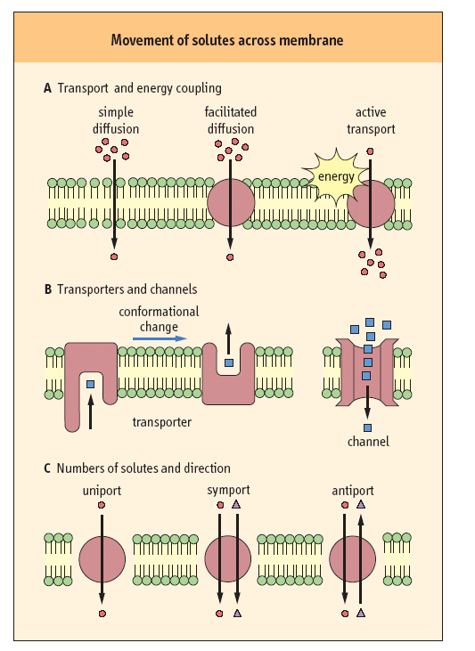

Slide 7
Depending on the changes produced
in the transmembrane electric voltage
Electroneutral transport – it does not change the value of the transmembrane potential (1Na⁺ and 1Cl⁻ in one direction or 1Na⁺ and 1K⁺ in opposite directions).
Electrogenic transport – it changes the membrane potential. For example charged particles of the same magnitude and sign of the charge are transported in one direction or charged particles of the different magnitude and same sign of the charge are transported in opposite direction (3Na⁺ against 2K⁺).

Slide 8
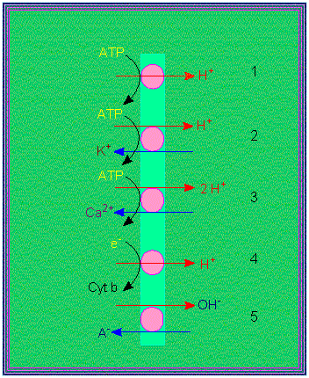
Proton pumps:
electrogenic pump
electroneutral pump
3. electroneutral pump with calcium as its counterion
4. electrogenic proton transport
5. electroneutral anion / OH antiport

Slide 9
Free diffusion of non-charged particles
C
Uniform medium
X
X
Uniform medium

Slide 10
Einstein in 1905 showed that diffusion coefficient (D) and mobility (u) can be related by:
D = uRT, where T is absolute temperature and u is particle mobility.
v=u F (u is a coefficient of proportionality which can be defined as the velocity of molecule per unit force). Thus Fick’s law can be rewritten in the following way:

Slide 11
Free diffusion of charged particles (Drift)
It is also called electrophoresis. It is the movement of electrically charged particles in electric fields.
Nernst-Planck molar flux equation

