Slide 1
PUBLIC HEALTH NEEDS OF SPECIAL POPULATION GROUPS
MEDICAL UNIVERSITY – PLEVEN
FACULTY OF PUBLIC HEALTH
DEPARTMENT OF PUBLIC HEALTH SCIENCES
DAY 5 INTERNSHIP
Prepared by:
Prof. Dr. Silviya Aleksandrova-Yankulovska, MD, PhD, MAS

Slide 2
MATERNAL and child HEALTH

Slide 3
- SIGNIFICANCE OF MCHC - CONTENT AND SPECIFIC OBJECTIVES OF MCHC - MATERNAL HEALTH CARE - CHILD HEALTH CARE - MATERNAL AND CHILD CARE AND MDGs
Outline of the lecture

Slide 4
SIGNIFICANCE OF MCHC - In any community, mothers and children constitute a priority group. - They comprise approximately 70% of the population of the developing countries, and about 45-50% in developed countries. - Mothers and children as “vulnerable” or high-risk group. For women the risk is connected with child-bearing. For infants children – with growth development and survival.

Slide 5
Mother and child – one unit 1.During the antenatal period the fetus is part of the mother. 2. Child health is closely related to maternal health. A healthy mother – a healthy baby. 3. Certain diseases and conditions during pregnancy (syphilis, german measles, AIDS, drug intake) are likely to have effects upon the fetus. 4. After birth the child is dependent upon the mother. 5. Almost all care services to the mother and child are closely related. 6. The mother is the first teacher of the child.

Slide 6
Nowadays, the current trend all over the world is to provide integrated maternal and child care and family planning services. New concepts: - social obstetrics - preventive paediatrics - social paediatrics

Slide 7
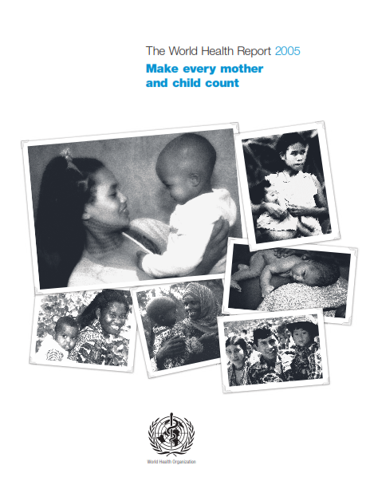
THE WORLD HEALTH REPORT 2005 MAKE EVERY MOTHER AND CHILD COUNT
The key message in WHR 2005 MOTHERS AND CHILDREN MATTER – SO DOES THEIR HEALTH

Slide 8
CONTENT AND SPECIFIC OBJECTIVES OF MCHC

Slide 9
MCH problems cover a broad spectrum. In developed regions perinatal problems, congenital malformations, genetic and behavioral problems In developing regions reduction of maternal and child mortality and morbidity, spacing of pregnancies, limitation of family size, prevention of communicable diseases, improvement of nutrition, promoting acceptance of health services.

Slide 10
MATERNAL AND CHILD HEALTH refers to the promotive, preventive, curative and rehabilitative health care for mothers and children. MCH includes the sub-areas: maternal health, child health, family planning, school health, handicapped children, adolescence and health aspects of children care in special settings.

Slide 11
Specific objectives of MCH globally: - reduction of maternal, perinatal, infant and childhood mortality and morbidity; - promotion of reproductive health; - promotion of the physical and psychological development of the child and adolescent within the family. The ultimate objective of MCH services is lifelong health.

Slide 12
MATERNAL HEALTH care

Slide 13
Antenatal care The primary aim – to achieve at the end of a pregnancy a healthy mother and a healthy baby.
Objectives of antenatal care: - to promote, protect and maintain the health of the mother during pregnancy; - to detect “high risk” pregnancies and give them special attention – high risk approach; - to foresee complications and prevent them; - to remove anxiety associated with delivery;
- to reduce maternal and infant mortality and morbidity; - to teach the mother elements of child care, nutrition, personal hygiene; - to sensitize the mother to the need of family planning including advice to cases seeking medical termination of pregnancy.

Slide 14
RISK APPROACH Introduced by WHO in 1970s as a strategy to determine high-risk groups in the population and to direct specific preventive measures to these groups and individuals in order to minimize the effects of risk factors.
High-risk pregnancies: - Elderly primi; - Short statured primi (140 cm and below); - Malpresentations, viz breech, transverse lie; - Antepartum haemorrage, threatened abortion; - Preeclampsia and eclampsia; - Anaemia;
- Twins, hudramnios; - Previous stillbirth, intrauterine death; - Elderly grandmultiparas; - Prolonged pregnancy (14 days after expected date of delivery); - History of previous caesarean or instrumental delivery; - General diseases (CVD, kidney disease, diabetes, tbc, liver disease, etc.)

Slide 15
Intranatal care The aims of a good intranatal care are to provide: - thorough asepsis; - delivery with minimum injury to the infant and mother; - readiness to deal with complications such as prolonged labour, antepartum haemorrhage, convulsions, malpresentations, prolapse of the cord, etc. - care of the baby at delivery – resuscitation, care of the cord, care of the eyes, etc. Domiciliary care Institutional care – for all high-risk cases

Slide 16
Postnatal care Care of the mother (postpartal care) – a responsibility of the obstetrician; Care of the newborn – a combined responsibility of the obstetrician and paediatrician
The objectives of postpartal care: - to prevent complications of the postpartal period; - to provide care for the rapid restoration of the mother to optimum health; - to check adequacy of beast feeding; - to provide family planning services; - to provide basic health education to mother/family.

Slide 17
Maternal mortality WHO Key facts
https://www.who.int/news-room/fact-sheets/detail/maternal-mortality
Every day in 2017, approximately 810 women died from preventable causes related to pregnancy and childbirth.
Between 2000 and 2017, the maternal mortality rate dropped by about 38% worldwide.
94% of all maternal deaths occur in low and lower middle-income countries.
Young adolescents (ages 10-14) face a higher risk of complications and death as a result of pregnancy than other women.
Skilled care before, during and after childbirth can save the lives of women and newborns.

Slide 18
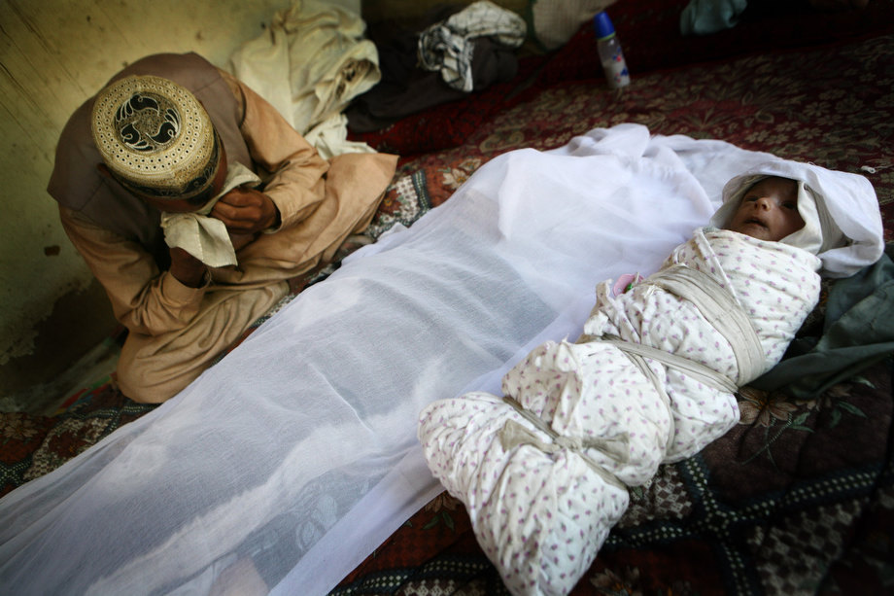
Where do maternal deaths occur? The high number of maternal deaths in some areas of the world reflects inequalities in access to quality health services and highlights the gap between rich and poor. The MMR in low income countries in 2017 is 462 per 100 000 live births versus 11 per 100 000 live births in high income countries.

Slide 19
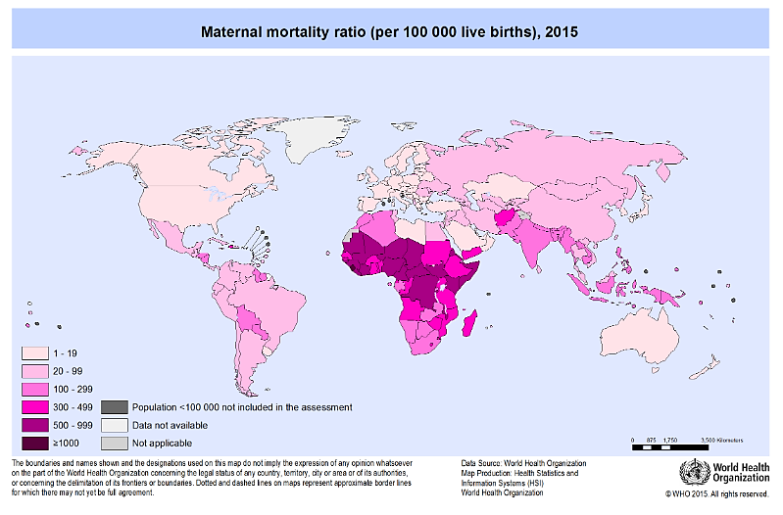

Slide 20
What are the leading causes of maternal deaths? direct or indirect causes in pregnancy, childbirth or the postpartum period
Major killers
Indirect causes
Severe bleeding
Infections
Hypertensive disorders
Obstructed labour
Complications after unsafe abortions (13%)
Diseases (20%) that complicate pregnancy or aggravated by pregnancy
Malaria
Anaemia
HIV/AIDS
CVD

Slide 21
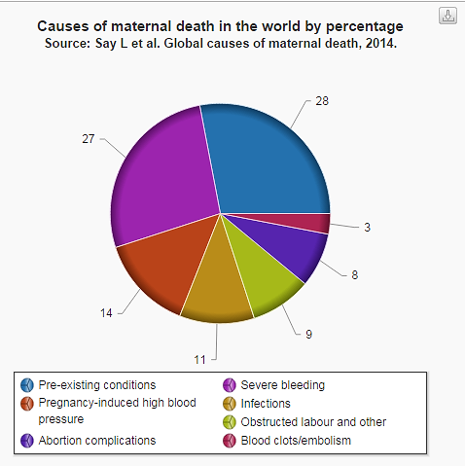

Slide 22
HOW CAN THE MOTHERS' LIVES BE SAVED? Most maternal deaths are avoidable as the medical solutions to prevent or manage the fatal causes are well known. Skilled care at birth (good quality of intranatal care) can make the difference between life and death. For instance, if unattended, severe bleeding in the third stage of labour can kill even a healthy woman within two hours. An injection of the drug oxytocin given immediately after childbirth reduces the risk of bleeding very effectively.

Slide 23
Sepsis, the second most frequent cause of maternal death, can be widely reduced if aseptic techniques are respected. The third-cause, pre-eclampsia, is a common hypertensive disorder in pregnancy, which can be monitored. Although pre-eclampsia cannot be completely cured before the delivery, the administration of drugs like magnesium sulfate can lower a woman's risk of developing convulsions (eclampsia).

Slide 24
Another frequent cause of maternal death, obstructed labour, can be prevented or managed by skilled birth attendants. Obstructed labour occurs when the fetus' head is too big compared to the mother's pelvis or if the baby is abnormally positioned. A simple tool to identify problems in labour early is the partograph to monitor the progress of labour and the maternal and fetal condition. Skilled practitioners can use the partograph to recognize and deal with slow progress before labour becomes obstructed, and, if necessary, reffer the woman to caesarean section.

Slide 25
WHY DO MOTHERS NOT GET THE CARE THEY NEED? The latest available data suggest that in most high income and upper middle income countries, more than 90% of all births benefit from the presence of a trained midwife, doctor or nurse. However, fewer than half of all births in several low income and lower-middle-income countries are assisted by such skilled health personnel.

Slide 26
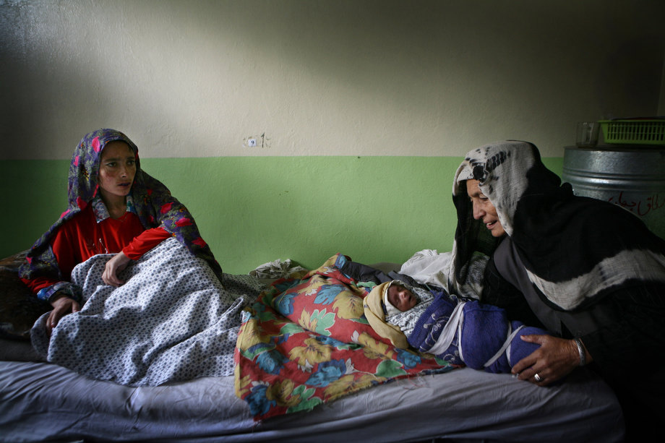
main factors that prevent women from receiving or seeking care
poverty
distance to facilities
lack of information
inadequate and poor quality services
cultural beliefs and practices.

Slide 27
The WHO strategy “MAKING PREGNANCY SAFER” is directed to: improve maternal health, assists countries to ensure skilled care before, during and after pregnancy and childbirth strengthen national health systems in order to achieve Millennium Development Goals.

Slide 28
A cornerstone of MAKING PREGNANCY SAFER is the integrated management of pregnancy and childbirth: - Guidance and tools to increase the availability of high-quality health services to pregnant women. - Clinical guidelines for the management of complications before, during and after childbirth - recommendations and standards for interventions for a continuum of care for mothers and newborns were developed. - involvement of individuals, families and communities to increase the access to quality care.

Slide 29
Millennium Development Goals MILLENIUM GOAL 5: IMPROVE MATERNAL HEALTH Target 1: Reduce by ¾ the maternal mortality ratio Target 2: Achieve universal access to reproductive health

Slide 30
Target 2: Achieve universal access to reproductive health

Slide 31
WHAT NEEDS TO BE DONE? 1. Provide sufficient financing to strengthen health systems for maternal, childcare and other reproductive health services, and ensure appropriate procurement and distribution of contraception, drugs and equipment. 2. Establish national programmes to reduce maternal mortality and ensure universal access to reproductive health care, including family planning services. 3. Provide trained health workers during and after pregnancy and childbirth for delivery of quality antenatal care, timely emergency obstetric services and contraception.

Slide 32
4. Ensure access to timely emergency obstetric services and provide adequate communication, skilled personnel, facilities and transportation systems, especially in areas where poverty, conflict, great distances and overloaded health systems obstruct such efforts. 5. Adopt and implement policies that protect poor families from the catastrophic consequences of unaffordable maternity care, including through access to health insurance or free services. 6. Protect pregnant women from domestic violence; and involve men in maternal health and wider reproductive health.

Slide 33
7. Increase access to contraception and sexual and reproductive health counseling for men, women and adolescents. 8. Increase efforts to prevent child marriage and ensure that young women postpone their first pregnancy.

Slide 35
CHILD HEALTH care

Slide 36
Care of children The age group 0-14 years is the most important in all societies because: - they constitute about 40% of the total population worldwide; - the determinants of chronic diseases and health behaviour are laid down at this stage; - it is a vital period of socialization and transmission of attitudes, customs and behaviour that may impact the health in later life, etc.

Slide 37
Age-periods of the childhood
Age-period | Common problems
Infancy | Infant mortality
Developed countries | Developing countries
1. Perinatal causes – asphyxia, hypoxia, injuries, low birth weight 2. Congenital abnormalities 3. Respiratory diseases | 1. Immunopreventable diseases – diphtheria, tetanus, whooping cough, measles, tuberculosis, poliomyelitis 2. Diarrhoea 3. Acute respiratory infections
Pre-school age | Malnutrition. Anaemia, xerophthalmia Infections. Respiratory infections, pneumonia, influenza. Intestinal infections and parasites. Accidents and poisoning. Burns and trauma form home accidents. Traffic accidents. Risk factors from the family background.
school age | Malnutrition Infectious diseases Intestinal parasites Diseases of skin, eye and ear Dental caries Spinal problems. Allergies. Asthma. Hypodynamics Neurosis. Psycho-emotional stress. Social adaptation. Sexual maturation

Slide 38
Infant mortality WHO Key facts
https://www.who.int/news-room/fact-sheets/detail/children-reducing-mortality
In 2018 an estimated 6.2 million children and adolescents under the age of 15 years died, mostly from preventable causes. Of these deaths, 5.3 million occurred in the first 5 years, with almost half of these in the first month of life.
Leading causes of death in children under-5 years are preterm birth complications, pneumonia, birth asphyxia, congenital anomalies, diarrhoea and malaria. Nearly half of these deaths are in newborns.
More than half of these early child deaths are preventable or can be treated with simple, affordable interventions including immunization, adequate nutrition, safe water and food and appropriate care by a trained health provider when needed.
Children in sub-Saharan Africa are more than 15 times more likely to die before the age of 5 than children in high income countries.

Slide 39
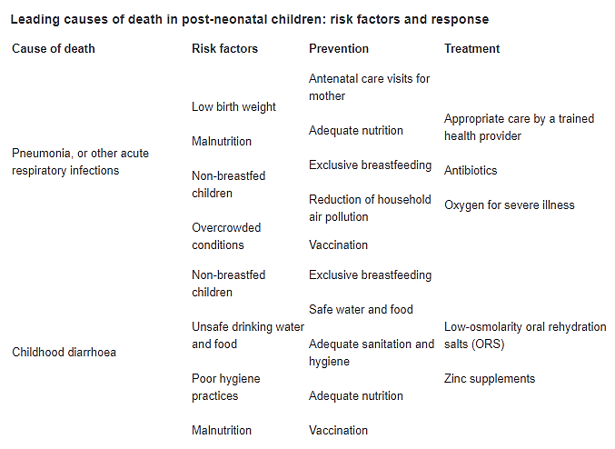

Slide 40
10 FACTS ON CHILD HEALTH

Slide 41
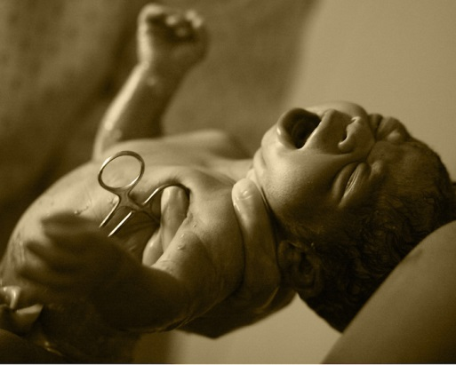
Fact 1 A child's risk of dying is highest in the first month of life. Preterm birth, birth asphyxia and infections cause most newborn deaths. Until the age of five years the main causes of deaths are pneumonia, diarrhoea, malaria, measles and HIV. Malnutrition contributes to more than half of all child deaths.

Slide 42
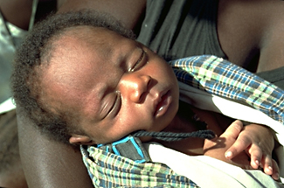
Fact 2 Annually almost four million children die in the first month of life. Health risks to newborns can be minimized by quality care during pregnancy, safe delivery by a skilled birth attendant, and strong neonatal care (immediate attention to breathing and warmth, hygienic cord and skin care, and exclusive breastfeeding).

Slide 43
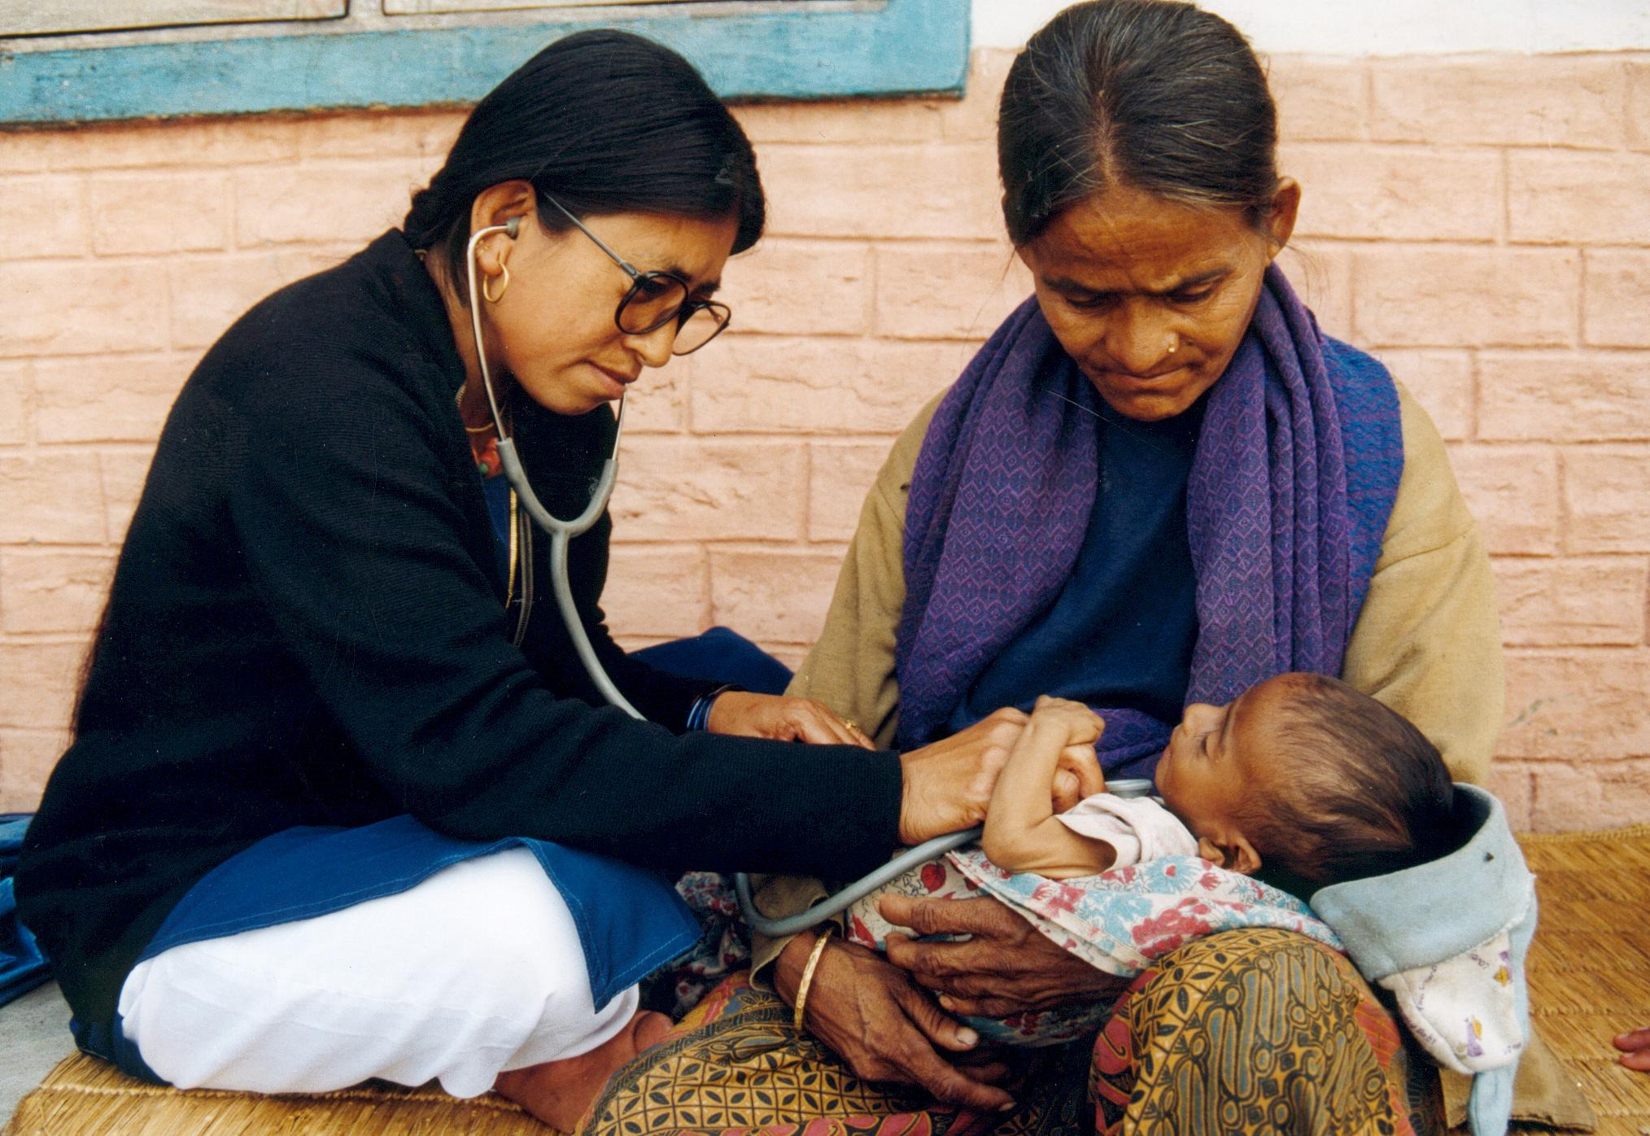
Fact 3 Pneumonia is the largest single cause of death in children under five years of age. Addressing the major risk factors for the illness is essential to prevention, along with vaccination. Antibiotics and oxygen are vital treatment tools for pneumonia.

Slide 44
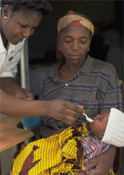
Fact 4 Diarrhoeal diseases are among the leading causes of sickness and death among children in developing countries. Breastfeeding helps prevent diarrhoea among young children. Treatment with Oral Rehydration Salts (ORS) and zinc supplements is cost-effective and saves lives.

Slide 45
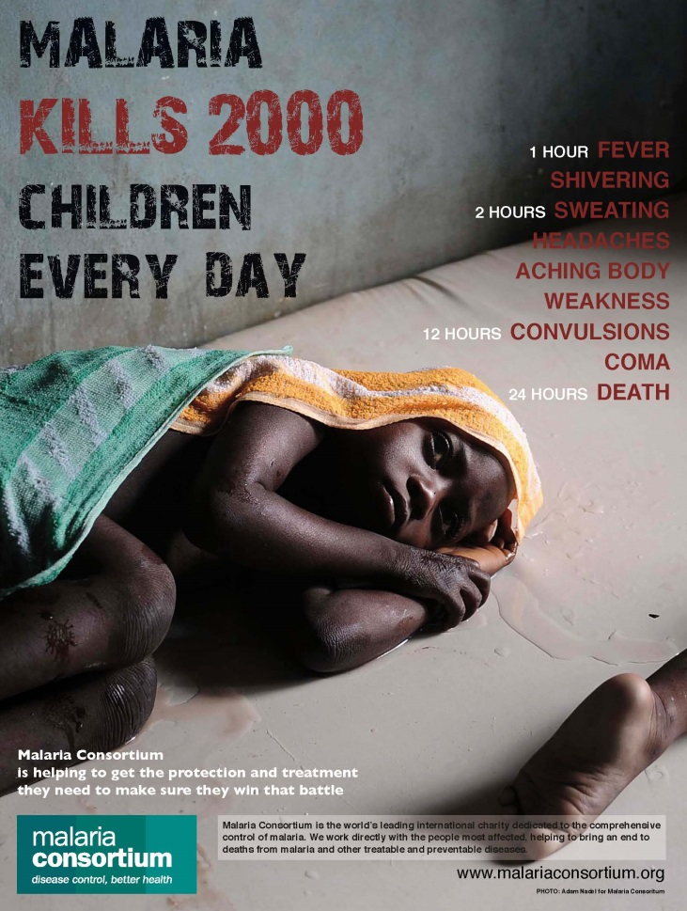
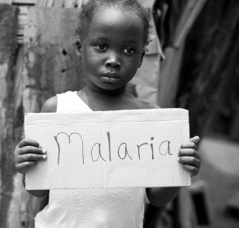
Fact 5 Every 30 seconds a child dies from malaria in Africa. It is the leading cause of death in that region among under-fives. Insecticide-treated nets prevent transmission and increase child survival. Early treatment with anti-malarial medication saves lives.

Slide 46
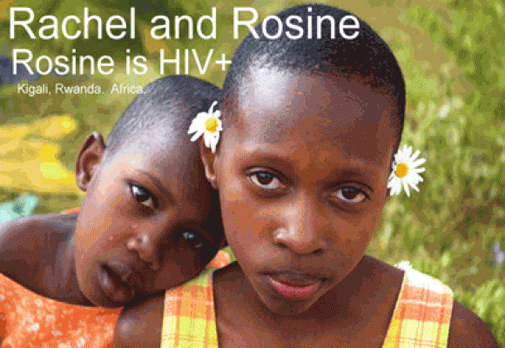
Fact 6 Over 90% of children with HIV are infected through mother-to-child transmission, which is preventable with the use of antiretrovirals and safer delivery and feeding practices. An estimated 2.3 million children under 15 years of age are living with HIV, and every day more than 1400 are newly infected. Without intervention, more than half of all HIV-infected children die before their second birthday.

Slide 47
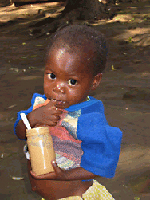
Fact 7 About 20 million children under five years of age worldwide are severely malnourished. Around three-quarters of them can be treated with "ready-to-use therapeutic foods". These highly fortified and energy-rich foods can be used at home without refrigeration, and even where hygiene conditions are not ideal.

Slide 48
Fact 8 Child survival rates differ significantly around the world - three-quarters of child deaths occur in Africa and South-East Asia. Within countries, child mortality is higher in rural areas, and among poorer and less educated families.

Slide 49
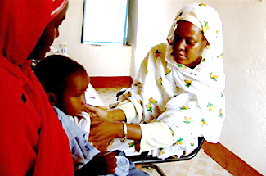
Fact 9 Child health is improving. About two-thirds of child deaths are preventable through access to practical, low-cost interventions, and effective primary care up to five years of age. Stronger health systems are crucial for improving access to care and prevention.

Slide 50
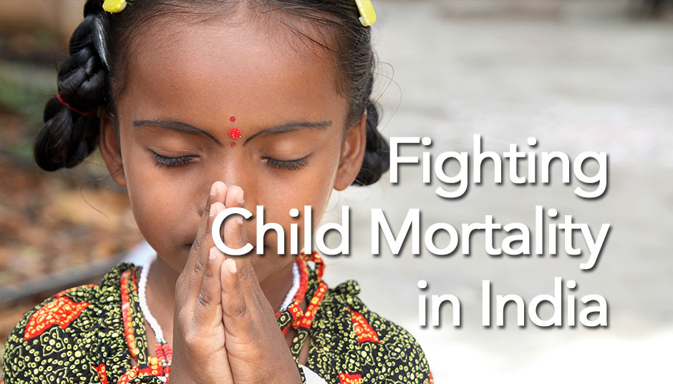
Fact 10 Greater investment is key to achieving reduction of under-five mortality rate. Public and private partners must come together to fill the gap in order to meet this goal. The launch of the International Health Partnership, the related Global Campaign for the Health MDGs, and several large bilateral donor pledges are important steps in this direction.

Slide 51
MILLENNIUM DEVELOPMENT GOAL 4: REDUCE CHILD MORTALITY Target 1: Reduce by two thirds, between 1990 and 2015, the under-five mortality rate

Slide 53
SUSTAINABLE DEVELOPMENT UN 2015 GOAL 3: end preventable deaths of newborns and under-5 children by 2030 Target 1: Reduce newborn mortality to at least as low as 12 per 1 000 live births in every country Target 2: Reduce under-five mortality to at least as low as 25 per 1,000 live births in every country

Slide 54
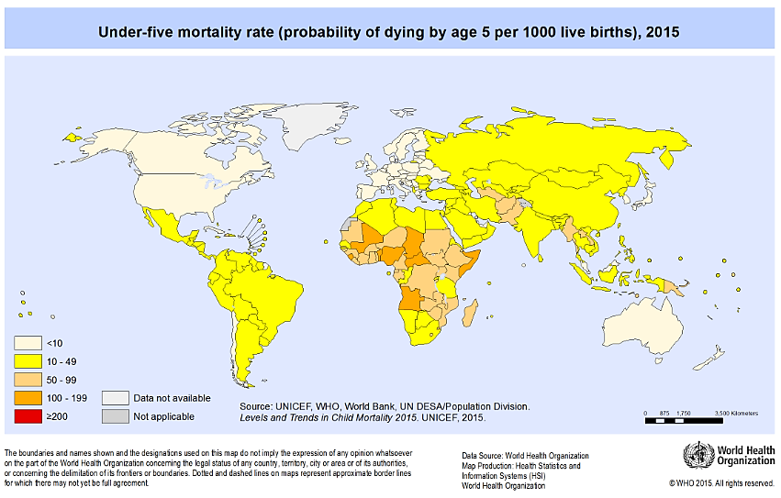

Slide 55
WHAT NEEDS TO BE DONE? Measures to achieve the necessary reductions in child mortality should include: 1. Ensure full coverage of immunization programmes. 2. Scale up vitamin A supplementation. 3. Pursue exclusive breastfeeding for children under 6 months of age and breastfeeding plus appropriate complementary feeding for children aged 6 months to two years.

Slide 56
4.Provide adequate nourishment for children of poor families, despite food price rises. 5. Promote hand-washing and treatment of home drinking water. 6. Target the underlying socioeconomic causes of child mortality such as mothers’ access to reproductive health, education and employment. 7. Prevent and provide effective treatment of pneumonia, diarrhoea, malaria and other infectious diseases.

Slide 57
8. Promote comprehensive and universal coverage of primary health-care systems - with the engagement of community health workers - accompanied by sustained delivery of health services and women’s education programmes. 9. Ensure sufficient financing for the strengthening of health systems to meet the demand for maternal and childcare and other reproductive health services.

Slide 58
PEOPLE WITH DISABILITIES

Slide 59
Definitions
By diagnosis: Traditional approaches to defining disability for public health have focused on equating a particular diagnosis with disability (e.g. blindness).
Focus on the impairment
Limitations in particular activities (e.g. self-care)
Identification of those with problems in working or going to school
Identification of those who need special programmes, e.g. special education
To ask the individuals themselves if they or others would identify them as someone with disability (self-identification)

Slide 60
Disability has traditionally been placed alongside morbidity and mortality as the negative public health outcomes.
⇒ preventing disabilities, therefore, has been a goal of public health activities
What happens to those who become disabled despite of our best primary prevention efforts?
Traditional approach – medical and rehabilitation services (outside the purview of public health)

Slide 61
Public health approach to people with disabilities
Assessment
Policy development
Assurance

Slide 62
Public health approach to people with disabilities
Assessment

Slide 63
ICF – International classification on Functioning, Disability and Health components
The ICF is a classification of health and health-related conditions for children and adults that was developed by WHO and published in 2001.
ICF classification system to be considered a partner to the ICD. Whereas the ICD classifies disease, the ICF looks at functioning. Therefore, the use of the two together would provide a more comprehensive picture of the health of persons and populations.
ICF is not based on etiology or "consequence of disease," but as a component of health. Thus, while functional status may be related to a health condition, knowing the health condition does not predict functional status.
ICF describes health and health related domains using standard language > wide application.

Slide 64
Benefits of ICF
Integration of the medical and social aspects of patient’s condition instead of solely focusing on his or her diagnosis.
Identifying the limitations of function is often the information used to plan and implement interventions.
Knowing how a disease affects one’s functioning enables better planning of services, treatment, and rehabilitation for persons with long-term disabilities or chronic conditions.

Slide 65
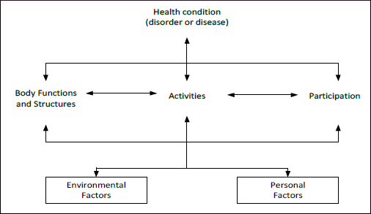
Components of IFC
Functioning and Disability
Contextual factors

Slide 66
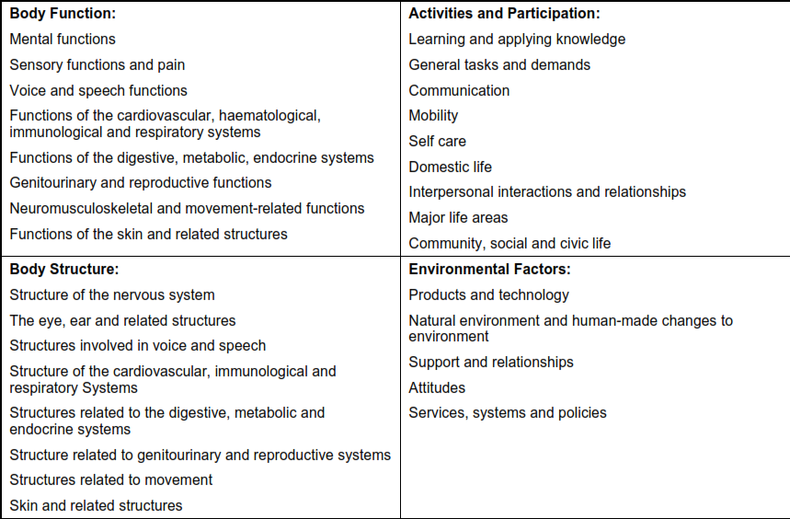
Chapters of ICF

Slide 67
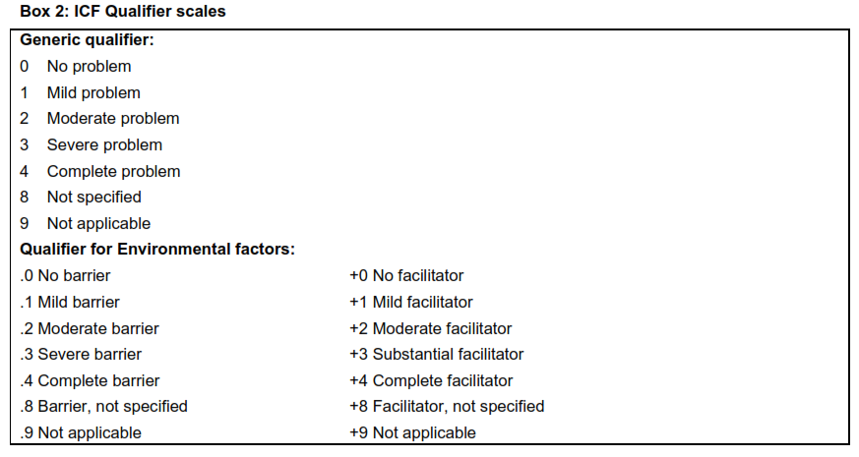

Slide 68
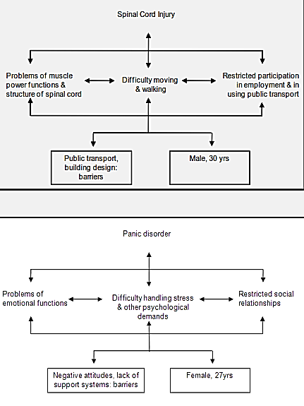

Slide 69
Public health approach to people with disabilities
Policy development

Slide 70
Why?
Data obtained about persons with disabilities alone do not make a difference in public health or in their own lives.
Policy development addresses the need for public health policies to use scientific knowledge in decision-making, as public health policy is best formulated on the foundation of strong data.

Slide 71
UN Standard rules on the equalization of opportunities for persons with disabilities (1993)
Preconditions Rule 1. Awareness raising Rule 2. Medical care Rule 3. Rehabilitation Rule 4. Support sevices | Target areas Rule 5. Accessibility Rule 6. Education Rule 7. Employment Rule 8. Income maintenance/ social security Rule 9. Family life and personal integrity Rule 10. Culture Rule 11. Recreation and sport Rule 12. Religion

Slide 72
UN Standard rules on the equalization of opportunities for persons with disabilities (1993)
Implementation measures Rule 13. Information and research Rule 14. Policy making and planning Rule 15. Legislation Rule 16. Economic policies Rule 17. Coordination of work | Rule 18. Organizations of people with disabilities Rule 19. Personnel training Rule 20. National monitoring/evaluation of disability programmes Rule 21. Technical and economic cooperation Rule 22. International cooperation

Slide 73
Public health approach to people with disabilities
Assurance

Slide 74
What does it mean?
Certitude that needed services will be provided to individuals and communities so that health goals can be reached;
Services must not only be present but also maintained so that goals can be met;
Not only presence of services but also access to those services :
Physical proximity
Reasonable transport to the services
Physical accessibility
Financial access
Attitudes that encourage participation in the services

Slide 75
ELDERLY

Slide 76
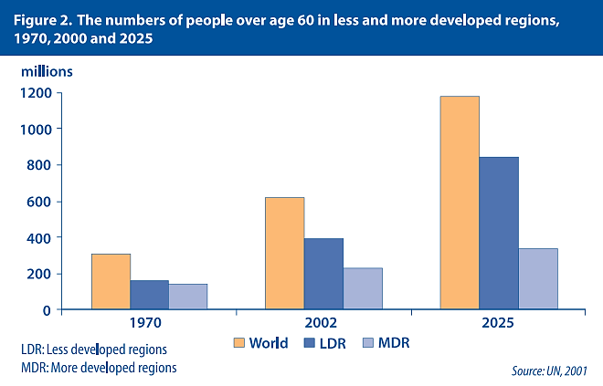

Slide 77
General characteristics
Aging is a continuous process of limitation over vitality and increase of disease susceptibility.
Higher incidence of physical and mental disorders.
Age specific diseases.
Increased risk for certain diseases.
Chronic multiple diseases.
Changed reactivity – severe diseases.
Blurred symptoms of disease.
More disease complications.

Slide 79
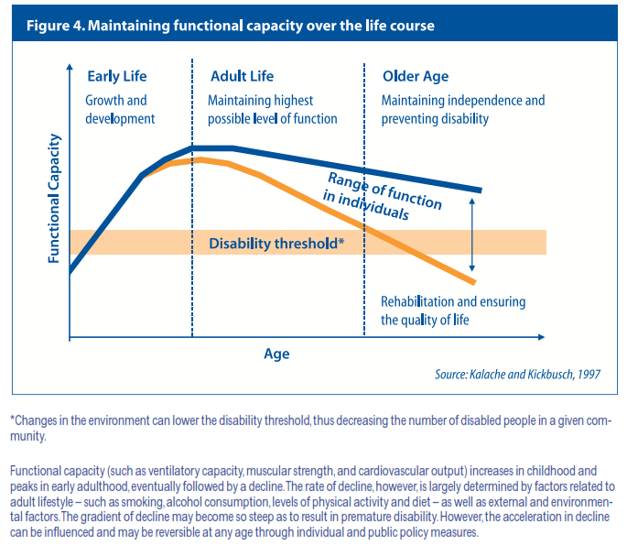

Slide 80
Leading health problems
Problems due to the ageing process | Senile caract Glaucoma Nerve deafness Bony changes Emphysema Failure of special senses Changes in mental outlook
Problems associated with long-term illness | Degenerative diseases of heart and blood vessels Cancer Accidents. Fracture neck of femur Diabetes Disease of locomotor system Respiratory illnesses. Chronic bronchitis. Asthma. Emphysema. Genitourinary system.
psychological problems | Mental changes Sexual adjustment Emotional disorders

Slide 81
Area potentially amenable to preventive health care in the elderly
primary | secondary | tertiary
1. Health habits Smoking Alcohol abuse Obesity Nutrition Sleep 2. Coronary heart disease risk factors 3. Immunization Influenza Pneumovax Tetanus 4. Injury prevention 5. Osteoporosis prevention | 1. Screening for Hypertension, diabetes Periodontal disease Sensory impairment Colo-rectal cancer Breast cancer, cervical cancer Prostatic cancer Nutritionally-induced anaemias Depression, stress Urinary incontinence Tuberculosis 2. Stroke prevention 3. Myocardial infarction | 1. Rehabilitation Physical deficits Cognitive deficits Functional deficits 2. Caretaker support Introduction of support necessary to prevent loss of autonomy

Slide 82
Madrid Action Plan on Aging 12 April 2002
We recognize that concerted action is required to transform the opportunities and the quality of life of men and women as they age and to ensure the sustainability of their support systems, thus building the foundation for a society for all ages.

Slide 83
Madrid Action Plan on Aging 12 April 2002
It focuses on three priority areas:
older persons and development;
advancing health and well-being into old age;
and ensuring enabling and supportive environments.
It is a resource for policymaking, suggesting ways for Governments, non-governmental organizations,and other actors to reorient the ways in which their societies perceive, interact with and care for their older citizens.

Slide 84
Madrid Action Plan on Aging 12 April 2002
Priority 1 – Older persons and development
Active participation in society and development
Recognition of the social, cultural, economic and political contribution of older people
Participation of older persons in decision-making processes at all levels
Work and the ageing labor force, employment opportunities for all older persons who want to work
Improvement of living conditions and infrastructure in rural areas
Access to knowledge, education and training
Full utilization of the potential and expertise of persons of all ages, recognizing the benefits of increased experience with age
Intergenerational solidarity
Sufficient minimum income for all age persons, paying particular attention to socially and economically disadvantaged groups

Slide 85
Madrid Action Plan on Aging 12 April 2002
Priority 2 – Advancing health and well-being into old age
Health promotion and well-being throughout life
Reduction of cumulative effects of factors that increase the risk of disease and consequently potential dependence in older age
Development of policies to prevent ill-health among older persons
Access to food and adequate nutrition for all older persons
Universal and equal access to health-care services
Development and strengthening of primary health care services to meet the needs of older persons and promote their inclusion in the process
Development od continuum of health care to meet the needs of older persons
Training of care providers and health professionals
Mental health needs of older persons
Older persons and disabilities

Slide 86
Madrid Action Plan on Aging 12 April 2002
Priority 3 – Ensuring enabling and supportive environments
Housing and the living environment
Improved availability of accessible and affordable transportation for older people
Care and support for caregivers
Images of ageing, enhancement of public recognition of the authority, wisdom, productivity and other important contributions of older people

Slide 87
ACTIVE AGING

Slide 88
Active aging
Active ageing is the process of optimizing opportunities for health, participation and security in order to enhance quality of life as people age.
Active ageing allows people to realize their potential for physical, social, and mental well-being throughout the life course and to participate in society, while providing them with adequate protection, security and care when they need.

Slide 89
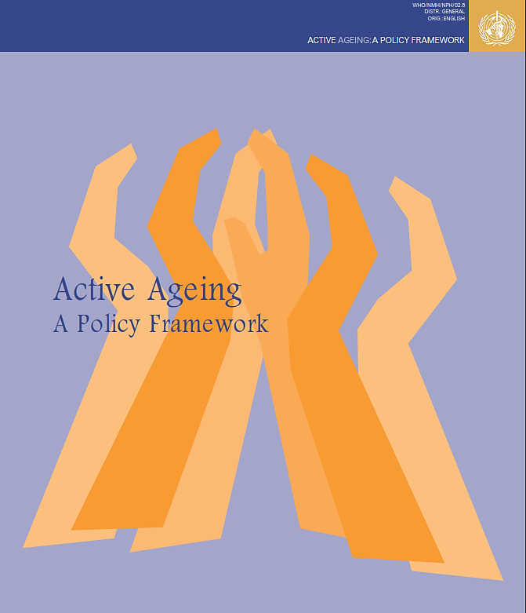
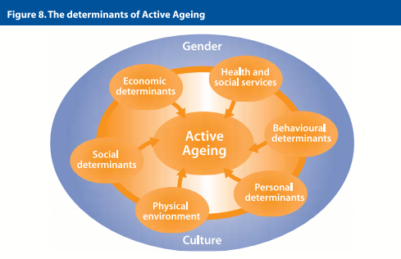

Slide 90
ACTIVE AGING INITIATIVES
1. WHO - Age Friendly Cities Programme. In 2007 WHO published guidelines to help cities become more age-friendly. It lists a number of requirements for age friendly outdoor spaces and buildings including the need for general cleanliness, seating both inside and outside, shelter from the elements, toilets, smooth nonslip surfaces, wheelchair access, ramps where needed, steps with rails and green spaces.

Slide 91
ACTIVE AGING INITIATIVES
2. Retired and senior volunteer programme – Retire into Action. This UK programme was established in 1988 and encourages people aged 50+ to get involved in local concerns. This programme within Community Service Volunteers (CSV) uses the wide range of skills and experience of older people to benefi t people in the community.

Slide 92
ACTIVE AGING INITIATIVES
3. Elderly Councils in France. Many French municipalities have senior consultative Council in which issues of interest to older citizens are debated and local policies or projects are discussed or proposed.
Their aims are to:
Facilitate dialogue between decision-makers and seniors
Inform older citizens on community projects and allow them to express their view and comments
Improve older people’s lives within the community and better respond to their needs

Slide 93
ACTIVE AGING INITIATIVES
4. Sustainable Learning in the Community. The SLIC project, coordinated by the Austrian Red Cross, aimed to empower older people to become active citizens, encouraging the development of skills and competences through formal and informal learning opportunities and directly linking the concepts of lifelong learning and community involvement.

