Slide 1
DECISION-MAKING IN MEDICAL PRACTICE
MEDICAL UNIVERSITY – PLEVEN
FACULTY OF PUBLIC HEALTH
distance learning Centre
Department of Public Health Sciences
LECTURE No2

Slide 2
Classical triad
of doctor-patient relationship
PATERNALISTIC MODEL
AUTONOMOUS MODEL
PARTNERSHIP MODEL

Slide 3
Model Criteria | PATERNALISM | AUTONOMOUS MODEL | MODEL OF PARTNERSHIP
physician’s position | strong | weak | strong
patient’s position | weak | strong | strong
leading ethical principle | beneficence | respect for autonomy | beneficence and respect for autonomy

Slide 4
PATERNALISTIC MODEL

Slide 5
In this model the ethical principle of beneficence is predominant, i.e. the autonomy is restricted by the reasons of patient’s beneficence. The decisions are taken by the doctor in behalf of the patient.
It does not need to be against the wants of the patient but it IGNORES to take into account the perspective of the patient and fails to treat the patient as an autonomous, rational being.

Slide 6
Case 1
Leila, an oncologist, decides on mastectomy for Sara, who has been diagnosed with breast-cancer—without consulting Sara as to her preferences in the situation. Leila’s decision on mastectomy happens to be in line with the preferences of Sara.
Is this a paternalistic act?

Slide 7
Case 2
Leila, after having asked Sara about her preferences, decide on a mastectomy—which is in line with Sara’s preferences. Sara is however not given the opportunity to further influence this decision and has not uthorised Leila to make the decision.
Is this a paternalistic act?

Slide 8
Yes, because:
Leila still supremely controls the reasoning process and is the one who makes the decision.
Sara has not explicitly authorised Leila to exercise such control, and neither has she delegated decisionmaking authority to Leila.

Slide 9
Then:
If a person, knowing someone’s preferences, acts to fulfil his preferences, without him either participating in the reasoning process leading up to the decision and partaking in the decision or having authorised the other person to make the decision on her own, she would act paternalistic.

Slide 10
The authorization to be valid:
Should be part of the actual decision making process so as to avoid paternalism.
Should be voluntary, non-coerced and well-informed.
The person should have the possibility to withdraw his authorisation without negative consequences due to actions taken by health care staff.
Should be given before the process is initiated.
Should be explicit.

Slide 11
Simple comparison:
If my mother decides to sell my car, which is what I want, without my permission (to save me the bother)—she would be acting paternalistically.
Sandman L, Munthe C. Shared Decision Making, Paternalism and patient Choice. Health Care Anal (2010); 18: 60-84.

Slide 12
Important conclusion in relation to the concept of autonomy
For others to care for my autonomy, it does not suffice that they act so that my goals are achieved. It is a crucial part of the notion of ‘self rule’ that it is me that achieve my goals.
Autonomy requires others to act so that I am helped to take such steps that promote whatever it is I care about.

Slide 13
Case 3
My wife buys me the suit I have been (what I thought) secretly longing for to my birthday—without me having authorised her to do so.
Is this a paternalistic act?
Sandman L, Munthe C. Shared Decision Making, Paternalism and patient Choice. Health Care Anal (2010); 18: 60-84.

Slide 14
No, because:
The question of paternalism only arises within certain fields of conduct, i.e., in relation to fields where the person has legitimate authority.
E.g. our own body, our own life and our own possessions—but we do not have legitimate authority over what someone should buy for our birthday etc.
Sandman L, Munthe C. Shared Decision Making, Paternalism and patient Choice. Health Care Anal (2010); 18: 60-84.

Slide 15
Case 4
The patient tells the professional about how he leads his life in different areas, what is generally important to him and his former experiences around health-problems. The professional incorporates this information into the decisional process and adapts the decision about treatment to what she has been told, in order to arrive at a result that suits this particular person’s circumstances.
Is this a paternalistic act?

Slide 16
Yes, because:
The physician is the one who interprets the information from the patient, reason from this to a decision and then makes the decision—all done without the patient explicitly authorising her to do so.
I. Patient Adapted Paternalism
Sandman L, Munthe C. Shared Decision Making, Paternalism and patient Choice. Health Care Anal (2010); 18: 60-84.

Slide 17
Case 5
The professional explores the preferences of the patient by listening to his opinions and motives, and then reason from these preferences and other relevant information in order to arrive at a decision that best satisfies the preference-set of the patient.
Is this a paternalistic act?

Slide 18
Yes, because:
The professional reasons alone. The authorization is still missing.
II. Patient Preference-Satisfaction Paternalism
Sandman L, Munthe C. Shared Decision Making, Paternalism and patient Choice. Health Care Anal (2010); 18: 60-84.

Slide 19
Case 6
The professional and patient both engage in a rational discussion or deliberation, trying to get all the relevant preferences, facts and reasons relating these aspects together on the table. In the end the professional decides on what option to choose.
Is this a paternalistic act?

Slide 20
Still Yes
III. Shared Rational Deliberative Paternalism
Sandman L, Munthe C. Shared Decision Making, Paternalism and patient Choice. Health Care Anal (2010); 18: 60-84.

Slide 21
In cases 4, 5 and 6 sharing was there
BUT the decision-making is still paternalistic!
Shared decision making (SDM) does not necessarily mean partnership.
SDM is not “good” by presumption.

Slide 22
AUTONOMOUS MODEL / CONSUMER MODEL

Slide 23
In this model the principle “respect for autonomy” is predominant. The decisions about patient’s health are taken by the patient himself on the condition that the patient is autonomous and is responsible for the consequences of the decision. The role of the physician is to provide information to the patient and to enforce his autonomy.

Slide 24
However, it is not “pure market model”
The patient chooses among existing alternatives.
The physician (or the institution) first decides on the range of alternatives that the patient can choose between = The physician frames the decisional situation.
Thus the physician does not have to sacrifice ethical and professional standards of ‘best practice’.
Sandman L, Munthe C. Shared Decision Making, Paternalism and patient Choice. Health Care Anal (2010); 18: 60-84.

Slide 25
PATIENT CHOICE

Slide 26
IV. INFORMED PATIENT CHOICE
Reminds Informative model of Emanuel&Emanuel
After having laid out the available options for the patient, the professional also explains relevant facts about these options (e.g. risks and benefits). The patient then decides on what option to choose.
The patient to have clear preferences on which he can base his decision with the help of the information shared by the professional.

Slide 27
V. INTERPRETATIVE PATIENT CHOICE
With the help of presented information and the patient’s opinions with regard to the options, the professional describes different ways of interpreting what the patient says in terms of lines of argument. The patient then decides on which of these to take into account in what way, and makes his decision on the basis of that.

Slide 28
VI. ADVISED PATIENT CHOICE
The professional also voices his opinion on what option she prefers, and why that is so. The patient then makes his decision on the basis of all that has been said.

Slide 29
VII. SHARED RATIONAL DELIBERATIVE PATIENT CHOICE
The professional and patient both engage in a rational discussion or deliberation, trying to get all the relevant preferences, facts and reasons relating these aspects together on the table. In the end the patient decides on what option to choose.

Slide 30
PERSON-CENTERED CARE
&
SHARED DECISION MAKING

Slide 31
What does it mean?
“Instead of treating the person as a collection of symptoms and behaviors to be controlled, person-centered care considers the whole person, taking into account each individual’s unique qualities, abilities, interests, preferences and needs.”
Alzheimer’s Society

Slide 32
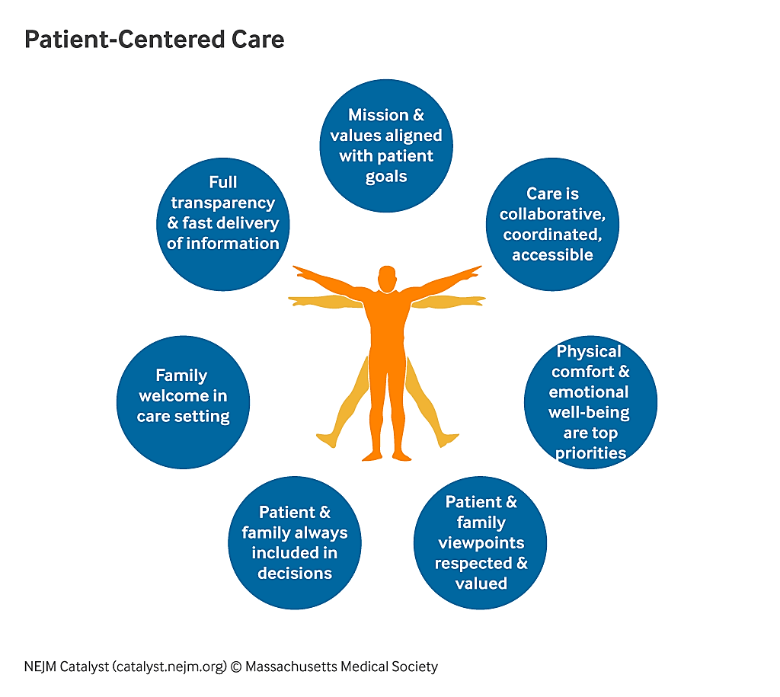

Slide 33
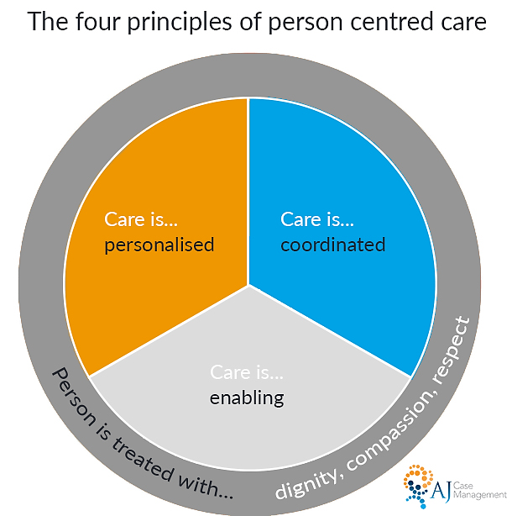

Slide 34
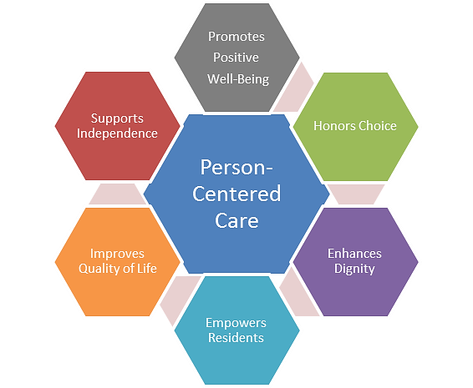

Slide 35
What does it mean?
PCC is clearly distinguished from a traditional treatment model which views the patient as a passive receiver of a medical intervention.
PCC allows for an inclusion of the patient and their relatives in making a joint design and mutual agreements of the medical plans and treatments
Within PCC shared decision-making (SDM) is considered to be one of the characteristic features.

Slide 36
Main aspects of SDM
Sharing: the decision making is being shared, or involves sharing.
Consensus: the final decision is mutually agreed upon
Charles, C., Gafni, A., & Whelan, T. (1997). Shared decision-making in the medical encounter: What does it mean? (or it takes at least two to tango). Social Science and Medicine, 44(5), 681–692.
Charles, C., Gafni, A., & Whelan, T. (1999). Decision-making in the physician–patient encounter: Revisiting the shared decision-making model. Social Science and Medicine, 49, 651–661.

Slide 37
The steps in the process of SDM
At a minimum, both the physician and patient are involved in the treatment decision-making process.
Both the physician and patient share information with each other.
Both the physician and the patient take steps to participate in the decision making process by expressing treatment preferences.
A treatment decision is made and both the physician and patient agree on the treatment to implement.
JOINT DELIBERATION
Charles, C., Gafni, A., & Whelan, T. (1999). Decision-making in the physician–patient encounter: Revisiting the shared decision-making model. Social Science and Medicine, 49, 651–661.

Slide 38
VIII. Shared Rational Deliberative Joint Decision
All parties should be given the opportunity to take part (generality constraint).
All the parties should be able to express needs, interests, suggestions, reasons etc. (autonomous evaluation constraint).
All parties should be open to consider the interest of the other party and allow their own interests to be radically questioned (role-taking constraint).
No goal or interest should be given more weight due to the position of the party (power neutrality constraint):
All interests, goals and reasons should be openly displayed (i.e., there should not be a hidden agenda) (transparency constraint).

Slide 39
IX. Professionally Driven Best Interest Compromise Model
The professional is given the opportunity to achieve a compromise that as far as possible sees to the patient’s efficient best interest (from the professional perspective) and at the same time is open to accommodate this to the value given to patient autonomy.
The professional is required to (openly) frame the decisional situation so as to achieve what she wants to achieve, although, at the same time, involving the patient in the decision making and ‘taking sharing all the way’ (thus caring for patient autonomy as far as is practically possible).
Better patient’s adherence than the paternalism.

Slide 40
Challenges
SDM presumes that patient want to share but it might not be the case.
Is the physician/caregiver competent to deal with the holistic patient narrative?
SDM enhances patient’s autonomy but not necessarily enhances health outcome.

Slide 41
SUMMARY (NEW) VARIANTS OF DECISION-MAKING
Patient Adapted Paternalism
Patient Preference-Satisfaction Paternalism
Shared Rational Deliberative Paternalism
Informed Patient Choice
Interpretative Patient Choice
Advised Patient Choice
Shared Rational Deliberative Patient Choice
Shared Rational Deliberative Joint Decision (ideal)
Professionally Driven Best Interest Compromise Model

