Slide 1
Pathogenesis and diagnosis of Diabetes mellitus
MEDICAL UNIVERSITY - PLEVEN
FACULTY OF MEDICINE
CLINIC OF ENDOCRINOLOGY AND METABOLIC DISEASES
COURSE IN ENDOCRINOLOGY
TASK №5

Slide 2
Diabetes mellitus is a syndrome of disordered metabolism with inappropriate hyperglycemia due either to an absolute deficiency of insulin secretion or a reduction in the biologic effectiveness of insulin (or both).

Slide 4
Endocrine Effects of Insulin.
Effect on liver:
Reversal of catabolic features of insulin deficiency
Inhibits glycogenolysis
Inhibits conversion of fatty acids and amino acids to keto acids
Inhibits conversion of amino acids to glucose
Anabolic action
Promotes glucose storage as glycogen (induces glucokinase and glycogen synthase, inhibits phosphorylase)
Increases triglyceride synthesis and very low density lipoprotein formation
Effect on muscle:
Increased protein synthesis
Increases amino acid transport
Increases ribosomal protein synthesis
Increased glycogen synthesis
Increases glucose transport
Induces glycogen synthetase and inhibits phosphorylase
Effect on adipose tissue:
Increased triglyceride storage
Lipoprotein lipase is induced and activated by insulin to hydrolyze triglycerides from lipoproteins
Glucose transport into cell provides glycerol phosphate to permit esterification of fatty acids supplied by lipoprotein transport
Intracellular lipase is inhibited by insulin

Slide 5
Etiologic classification of diabetes mellitus.
I. Type 1 diabetes2 (B cell destruction, usually leading to absolute insulin deficiency)
A. Immune-mediated
B. Idiopathic
II. Type 2 diabetes2 (may range from predominantly insulin resistance with relative insulin deficiency to a predominantly secretory defect with insulin resistance)
III. Other specific types
A. Genetic defects of B cell function
1. Chromosome 12, HNF-1 (MODY 3)
2. Chromosome 7, glucokinase (MODY 2)
3. Chromosome 20, HNF-4 (MODY 1)
4. Chromosome 13, IPF1 (MODY 4)
5. Chromosome 17, HNF-1 (MODY 5)
6. Chromosome 2, Neuro D1 (MODY 6)
7. Mitochrondrial DNA
8. Others
B. Genetic defects in insulin action
1. Type A insulin resistance
2. Leprechaunism
3. Rabson-Mendenhall syndrome
4. Lipoatrophic diabetes
5. Others

Slide 6
C. Diseases of the exocrine pancreas
1. Pancreatitis
2. Trauma, pancreatectomy
3. Neoplasia
4. Cystic fibrosis
5. Hemochromatosis
6. Fibrocalculous pancreatopathy
7. Others
D. Endocrinopathies
1. Acromegaly
2. Cushing's syndrome
3. Glucagonoma
4. Pheochromocytoma
5. Hyperthyroidism
6. Somatostatinoma
7. Aldosteronoma
8. Others

Slide 7
E. Drug- or chemical-induced
1. Vacor
2. Pentamidine
3. Nicotinic acid
4. Glucocorticoids
5. Thyroid hormone
6. Diazoxide
7. Beta-adrenergic agonists
8. Thiazides
9. Phenytoin
10. Alpha-interferon
11. Others
F. Infections
1. Congenital rubella
2. Cytomegalovirus
3. Others
G. Uncommon forms of immune-mediated diabetes
1. Stiff-man syndrome
2. Anti-insulin receptor antibodies
3. Others

Slide 8
H. Other genetic syndromes sometimes associated with diabetes
1. Down's syndrome
2. Klinefelter's syndrome
3. Turner's syndrome
4. Wolfram's syndrome
5. Friedreich's ataxia
6. Huntington's chorea
7. Laurence-Moon-Biedl syndrome
8. Myotonic dystrophy
9. Porphyria
10. Prader-Willi syndrome
11. Others
IV. Gestational diabetes mellitus (GDM)
Modified from American Diabetes Association: Diabetes Care 1999;22(Suppl 1):1185.
Notes:
HNF = hepatic nuclear factor.

Slide 9
Patients with any form of diabetes may require insulin treatment at some stage of their disease. Such use of insulin does not, of itself, classify the patient.
The terms "insulin-independent diabetes mellitus" and "non-insulin-dependent diabetes mellitus" and their acronyms IDDM and NIDDM were eliminated because they are based on pharmacologic rather than etiologic considerations.
The terms "type 1 diabetes" and "type 2 diabetes" are retained, with arabic rather than roman numerals.
Type 1 diabetes is due to pancreatic islet cell destruction, which is caused by an autoimmune process in more than 95% of cases, whereas the cause of cell destruction is idiopathic in less than 5% of cases. Patients with type 1 diabetes are generally prone to ketoacidosis and require insulin replacement therapy.
Type 2 diabetes, the much more prevalent form, is a heterogeneous disorder encompassing a spectrum of defects consisting in some cases of defects in cell function alone but most commonly associated with insulin resistance in the presence of an associated impairment in compensatory insulin secretion.

Slide 10
Comparisons of Type 1 & Type 2
Type 1 (5-10%)
Sudden onset
Severe symptoms
Weight loss
Lean
Ketosis
Absent C-peptides
Markers of autoimmunity present
Family history uncommon
Onset usually in the young
Type 2 (90-95%)
Gradual onset
May be Asymptomatic
Often no weight loss
Usually obese
Not ketotic
C-peptide detectable
No markers of autoimmunity present
Family history
Onset usually >40 years old
Notes:
Insulin resistance is a characteristic feature of both obesity and diabetes - there are fewer insulin receptors as well as there being faults potentially with the receptors so the body is not able to respond adequately
Insulin resistance is thought to be caused by both genetic factors and lifestyle. Modern lifestyles with rich diets and little exercise have been linked to insulin resistance and Type 2 diabetes. An increase in body weight can trigger insulin resistance in people who are genetically prone to the condition. More than 25 % of people worldwide are estimated to be insulin resistant, although this does not mean that they have diabetes.
Insulin resistance is also linked to other conditions, such as high blood pressure and cholesterol problems, which can lead to heart and circulation problems. This may be why people with Type 2 diabetes are more likely to suffer from heart disease or stroke. In fact, heart disease is the most common cause of death amongst people with Type 2 diabetes.
Syndrome X is a cluster of features such as glucose intolerance, obesity, hypertension, accelerated atherosclerosis,low HDL and high triglycerides and VLDL. Other abnormalities are increased clotting due to increased levels of fibrinogen.

Slide 11
TYPE 1 DIABETHES
Characterized by absolute insulin deficiency
Pathophysiology and etiology
Result of pancreatic beta cell destruction
Total deficit of circulating insulin
Autoimmune-90%
Idiopathic-10%
Diabetes mellitus type 1 occurs at any age but most commonly arises in children and young adults with a peak incidence before school age and again at around puberty.
Family members of diabetic probands have an increased lifetime risk of developing type 1 diabetes. The offspring of a mother with type 1 diabetes have a risk of 3%, whereas the risk is 6% if the father is affected.

Slide 12
Type 1 Diabetes

Slide 13
Pathophysiology of T1DM
Chronic autoimmune disorder occurring in genetically susceptible individuals
May be precipitated by environmental factors
Immune system is triggered to develop an autoimmune response against
Altered pancreatic beta cell antigens
Molecules in beta cells that resemble a viral protein
~ 85% of T1DM patients have circulating islet cell antibodies
Majority also have detectable anti-insulin antibodies
Most islet cell antibodies are directed against glutamic acid decarboxylase (GAD) within pancreatic beta cells
Maahs DM, et al. Endocrinol Metab Clin North Am. 2010;39:481-497.

Slide 14
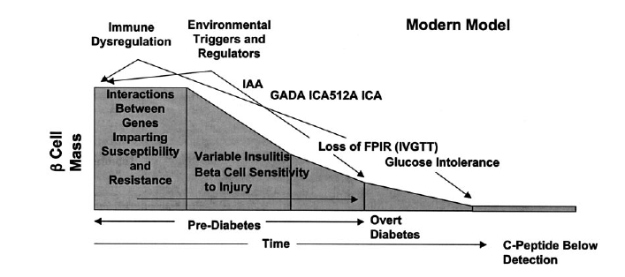
Autoimmune Basis for Type 1 Diabetes
Atkinson MA. Diabetes. 2005;54:1253-1263.

Slide 15
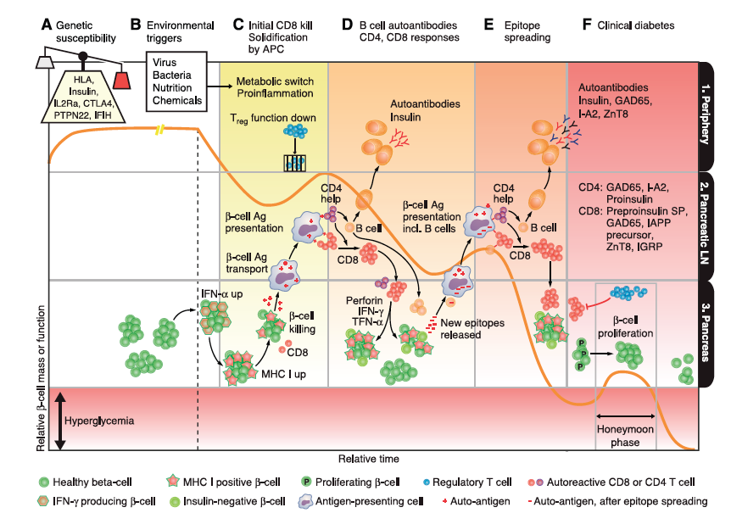
How Type 1 Diabetes Might Arise
van Belle TL, et al. Physiol Rev. 2011;91:79-118.

Slide 16
Insulin and Glucose Metabolism
Major Metabolic Effects of Insulin
Consequences of Insulin Deficiency
Hyperglycemia → osmotic diuresis and dehydration
Stimulates glucose uptake into muscle and adipose cells
Inhibits hepatic glucose production

Slide 17
Major Metabolic Effects of Insulin and Consequences of Insulin Deficiency
Insulin effects: inhibits breakdown of triglycerides (lipolysis) in adipose tissue
Consequences of insulin deficiency: elevated FFA levels
Insulin effects: Inhibits ketogenesis
Consequences of insulin deficiency: ketoacidosis, production of ketone bodies
Insulin effects in muscle: stimulates amino acid uptake and protein synthesis, inhibits protein degradation, regulates gene transcription
Consequences of insulin deficiency: muscle wasting

Slide 18
TYPE 2 DIABETHES
Overview of the pathogenesis of T2D
Insulin secretory dysfunction
Insulin resistance (muscle, fat, liver)
Increased endogenous glucose production
Decreased incretin effect
Deranged adipocyte biology
Diabetes Care 2012;35:1364–1379; Diabetologia 2012;55:1577–1596
Notes:
The pathogenesis of T2DM is complex with multiple defects in multiple organ systems. Insulin resistance appears to be a primary defect, followed by relative beta cell failure with insulin secretory abnormalities, and increased endogenous (hepatic) glucose production. There are also derangements in incretin physiology and in the certain aspects of adipocyte biology.

Slide 19
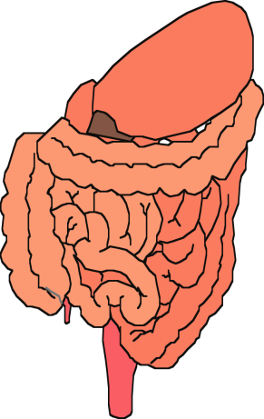
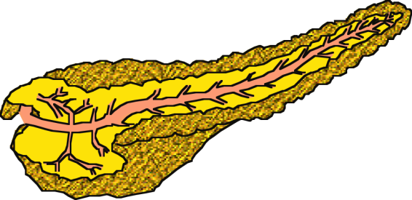
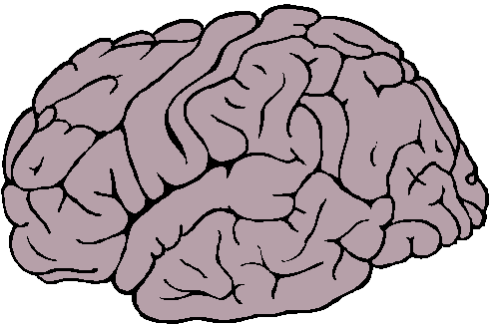
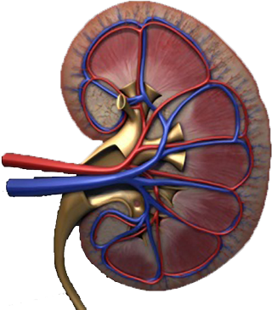
Multiple, Complex Pathophysiological Abnormalities in T2DM
pancreatic
insulin
secretion
incretin
effect
pancreatic
glucagon
secretion
_
?
gut
carbohydrate
delivery &
absorption
HYPERGLYCEMIA
_
+
peripheral
glucose
uptake
hepatic
glucose
production
renal glucose excretion
Adapted from: Inzucchi SE, Sherwin RS in: Cecil Medicine 2011
Notes:
This slide provides a broad overview of the main pathophysiological defects in type 2 diabetes. Insulin resistance is demonstrated in peripheral tissues, such as skeletal muscle and adipocytes. The pancreas develops relative insulin secretory failure and is no longer provide the amount of insulin required for normal glucose. The pancreas also demonstrates a failure of the normal suppression of glucagon after meals. This may be mediated through abnormalities in the incretin axis. Hepatic glucose production is also increased. Renal glucose output is set at a higer threshold than normal. Many of these defects may be influenced by abnormal central control of metabolism.

Slide 20
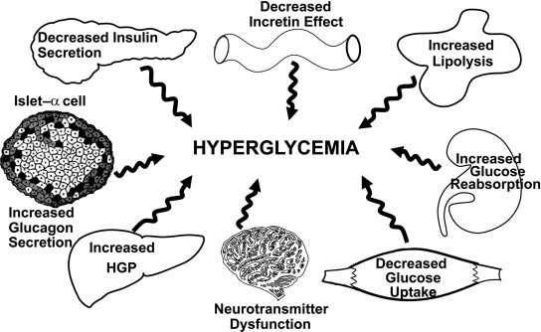

Slide 21
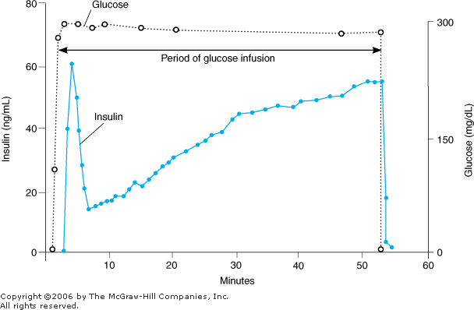

Slide 24
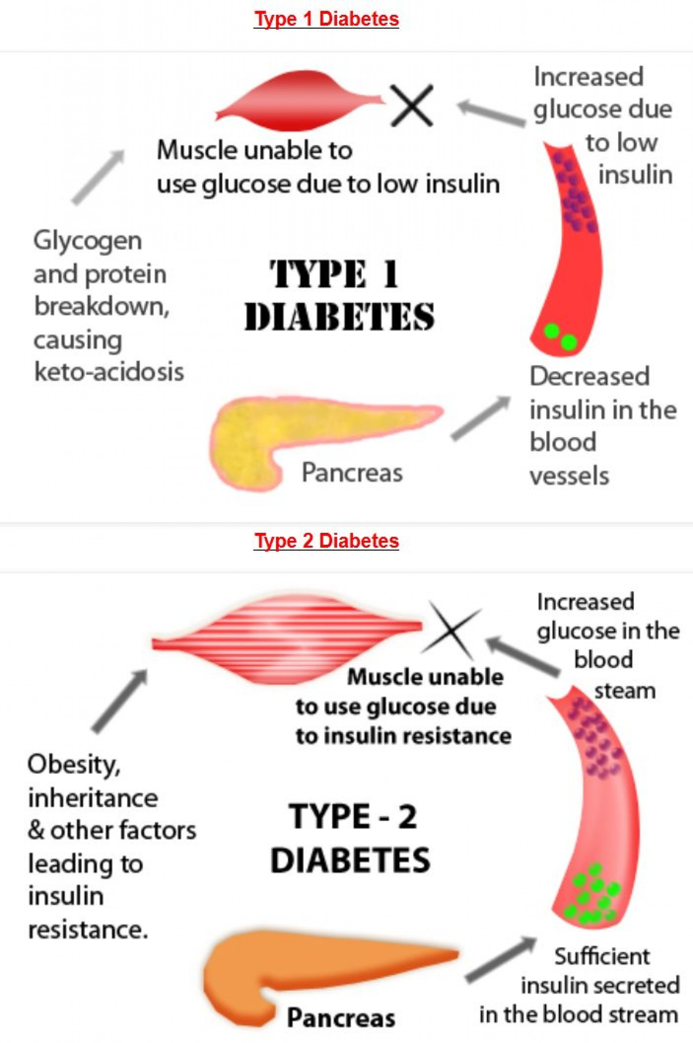

Slide 25
Categories of increased risk for diabetes (prediabetes)*.
American Diabetes Association Dia Care 2014;37:S81-S90
©2014 by American Diabetes Association
Notes:
Categories of increased risk for diabetes (prediabetes)*

Slide 26
Diagnosis of Diabetes
Two pieces of evidence required
Symptoms
Random Venous Plasma Glucose > 11.1
Fasting Venous Plasma Glucose > 7.0
2 Hour Venous Plasma Glucose > 11.1
WHO 1999
Notes:
Key point: must be stressed that the sample must be venous as all the assays and evidence based criteria are based on venous samples. There are legal implications for improper diagnosis especially if diagnostic criteria are not followed.
If capillary blood was used there would be different readings (from venous- and therefore not match the criteria) and coupled if a machine is used there is the accuracy of the machine to take in to account
Similarly because HbA1c is not universally available and there is lack of standardization of tests and results and therefore cannot be used.
HbA1c-stands for glycated haemoglobin and where the glucose has attached itself to the haemoglobin of red blood cell. The life of the red blood cell lasts for about 120 days and therefore measure glucose control over this period of time with greater weighting on the more recent blood glucose reading than earlier ones.
Urine testing – is not a predictor of diabetes – as thresholds can vary normal is about 10mmol/l. Therefore people with a low renal threshold tend to show glycosuria more readily and on the other side of the coin those with a high threshold may not show and diabetes go undetected. This is particularly relevant to people of older age and people of younger age who may have low/high thresholds. We therefore need more accurate measurements.

Slide 27
Criteria for the diagnosis of diabetes.
American Diabetes Association Dia Care 2014;37:S81-S90
©2014 by American Diabetes Association
Notes:
Criteria for the diagnosis of diabetes

Slide 28
Glucose Tolerance Test
3 days of unrestricted diet and exercise
Evening meal as normal the night before
Overnight fast of 8-14 hours
TEST
Fasting blood on the morning
Drink 75g of anhydrous glucose in 250-300ml water over 5 mins
Blood sample 2 hours later
No smoking during the test
Notes:
Oral glucose tolerance tests should be used on all individuals that have an impaired fasting glucose – where blood glucose levels are above the norm but below the diagnostic criteria for diabetes. The DECODE study found that these individuals along with Impaired Glucose tolerance subjects were at much greater risk of developing diabetes as well as cardiovascular disease.
The difference between IFT and IGT is that one is done fasting the other is done post prandially (ie after a meal and when CHO load at its peak)
Many people with Type 2 may have been walking around with undiagnosed diabetes and evidence suggests that on average it takes 10 years to present with a decline of 4% pancreatic function every year and thereafter diagnosis.

Slide 29
DIAGNOSIS AFTER AN OGTT
 | Impaired Fasting Glucose (IFG) | Impaired Glucose Tolerance (IGT) | Diabetes
Fasting Venous Plasma Glucose | 6.1 mmol/l to 6.9 mmol/l | <7.0 mmol/l | > 7.0 mmol/l
2 hr post | < 7.8 mmo/l | >7.8 mmol/l up to 11.1 mmol/l | >11.1 mmol/l (WHO,2006)

Slide 30
Impaired Glucose Regulation
Impaired Glucose Tolerance (IGT)
- Abnormalities in glucose regulation in the post-prandial state.
- More common in women
Impaired Fasting Glucose (IFG)
- Elevated fasting glucose concentrations, but lower than those required to diagnose diabetes
- More common in men

Slide 31
Impaired Glucose Regulation
Both can lead to diabetes or revert to normoglycaemia
Both are associated with an increased risk of Cardiovascular disease

Slide 34
HbA1c Criteria
Recently agreed by WHO & Diabetes UK
Provides positive identification
- If Hba1c > 48mmol/mol(6,5%), twice or once in presence of osmotic symptoms, and…
- if no confounding clinical problems
Fails to rule out normality
- Hba1c <48mmol/mol does not rule out diabetes
- glucose criteria then remain essential
A value of less than 48 mmol/mol (6.5%) does not exclude diabetes, which can still be diagnosed using glucose tests.
Algorithm not widely agreed.

Slide 35
Use HbA1c– for patients under investigation, or annual assessment of at risk groups including
IFG / IGT
Metabolic syndrome
PMH Gestational Diabetes or large for dates baby (>4kg)
Established Vascular disease CVA, IHD, PVD
Age > 45 plus + Family history
Age > 40 (or >30 if Asian or Pacific island descent) with hypertension & BMI>30
PCOS

Slide 36
Do not use HbA1c
Under 18 yrs
Possible Type 1
Where glucose may rise rapidly e.g.: steroids, antipsychotics.
Reduced red cell survival e.g. haemolytic anaemia
Gestational Diabetes
Pancreatic damage/surgery
Anaemia/Haemoglobinopathy

Slide 37
Notes:
ADA Type 1 Diabetes Position Statement 2014
This slide details A1C targets for nonpregnant individuals.
Youth (age <18 yrs): <7.5%
Adults: <7.0%
Healthy older adults (long life expectancy, no comorbidities): <7.5%
Complex/intermediate older adults: <8.0%
Very complex/older adults in poor health: <8.5%
Glycemic targets should be individualized according to diabetes duration, age/life expectancy, comorbidities, known cardiovascular disease or advanced microvascular complications, hypoglycemia unawareness, and individual patient considerations.
Chiang JL, Kirkman S, Laffel LMB, et al; for the Type 1 Diabetes Sourcebook Authors. Diabetes Care. 2014;37:2034-2054.

Slide 38
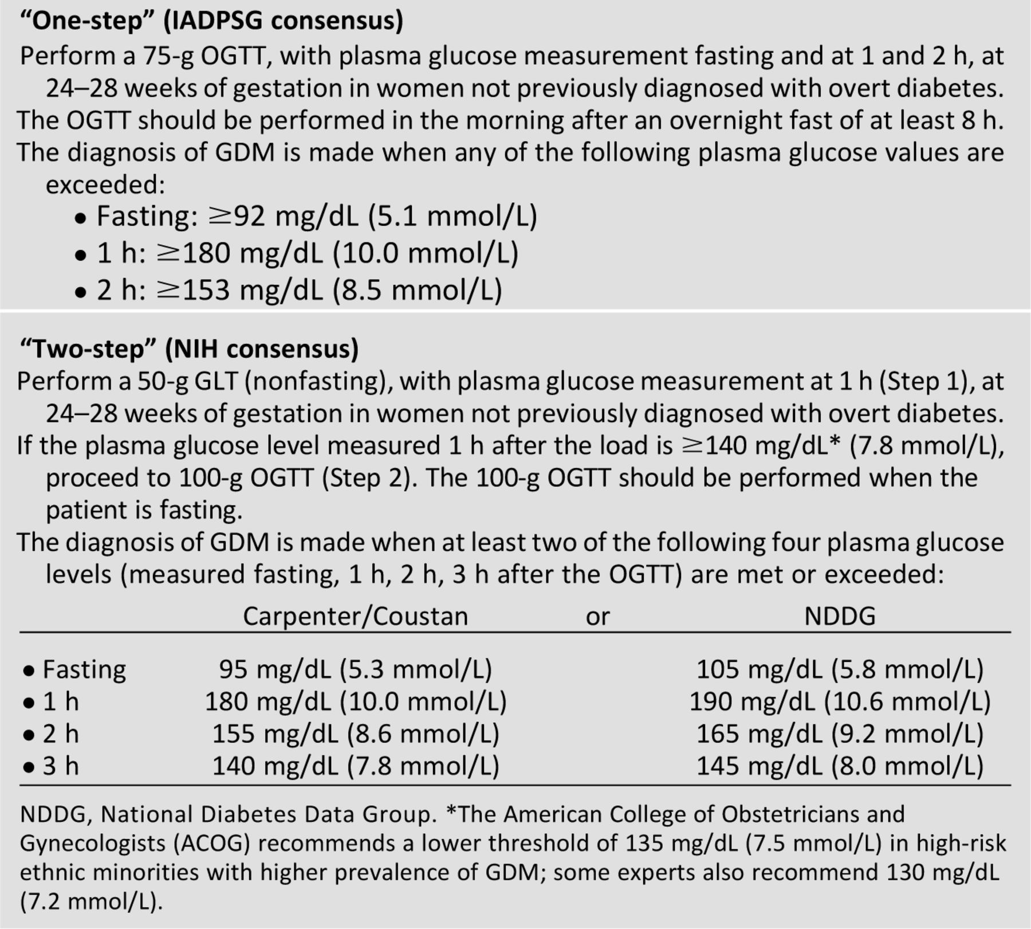
Screening for and diagnosis of GDM.
American Diabetes Association Dia Care 2014;37:S81-S90
©2014 by American Diabetes Association
Notes:
Screening for and diagnosis of GDM

